Slide 1
Rotation Invariant multi-object detector
PID 17
Project Guide: E Padmalatha
Project InCharge:
Dr. K Sagar
Ms. CH Vijayalaksmi
Kanishka S 160117733031
Praneeth Reddy M 160117733036

Slide 2
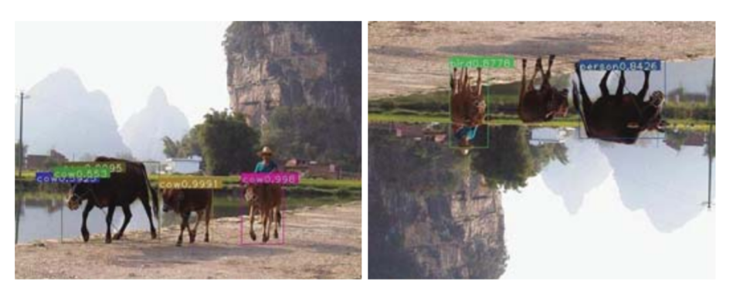
Brief explanation of the problem.
YOLOv3 detection accuracy performance on original and rotated images
Features extracted by CNNs are variant to small changes in shift and scale.
So, all the images that pass through an object detector, must be in the same orientation(as it is only trained on images at a specific orientation and CNNs are unable to disentangle planar rotation transformations).

Slide 3
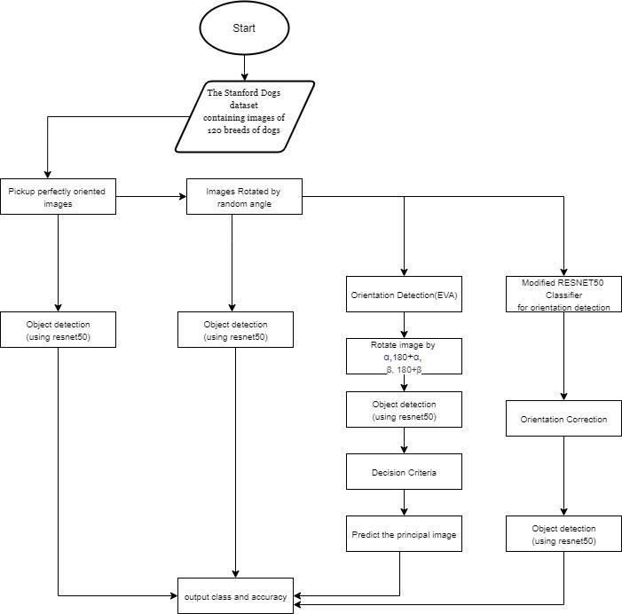
Methodology

Slide 4
Base Paper 1:
Using the same trained CNN multiple times.
Input image is arbitrarily rotated by random orientations
Rotated images fed to each instance of the architecture.
Requires less number of images for training.
Offers an additional advantage of finding the approximate orientation of the object in an image, without any additional computational complexity.
We are using ResNet50 for both orientation correction as well as objection detection.
Considering this as a Classification problem, we have replaced the output layer of ResNet50 with another Dense layer which classifies the image into 0 to 359 degrees.

Slide 5
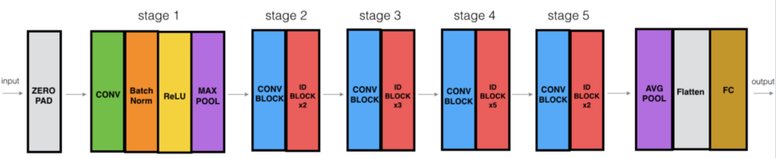
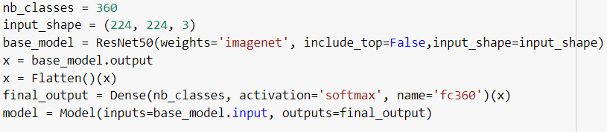
ResNet-50 for Angle Classification

Slide 6
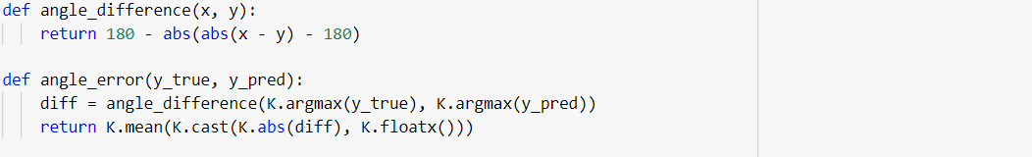
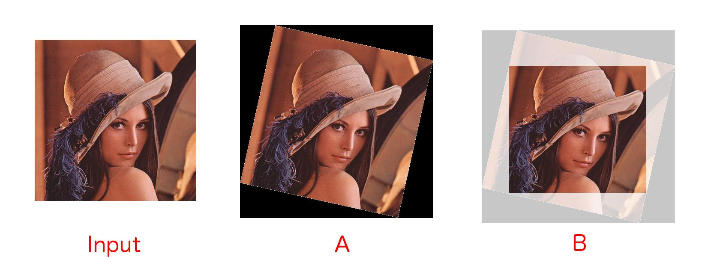

Slide 7
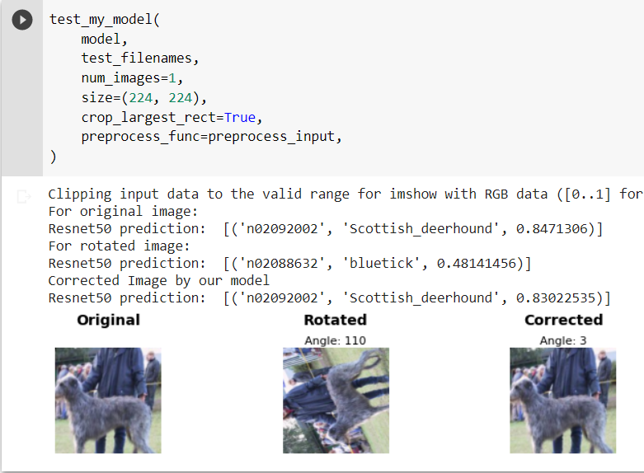

Slide 8
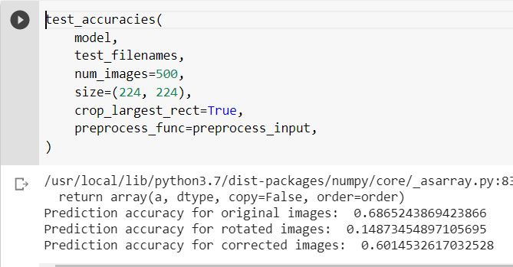
Prediction accuracies for test dataset
Relative performance: 0.8760843360

Slide 9
Base paper 2 : Eigen Vectors based Rotation Invariant Object Detector
GOAL : Detect the orientation of an object, and correct the object’s orientation if it is identified as different from the base orientation.
Discusses novel two-step architecture, which detects multiple objects at any angle in an image efficiently.
Utilizes eigenvector analysis on the input image based on bright pixel distribution.
This analysis gives four orientations of the input image which, then pass through a pre-trained ResNet50 with proposed decision criteria.
This approach produces rotation invariant detection without any additional training on augmented data and also determines actual image orientation without any prior information.

Slide 10
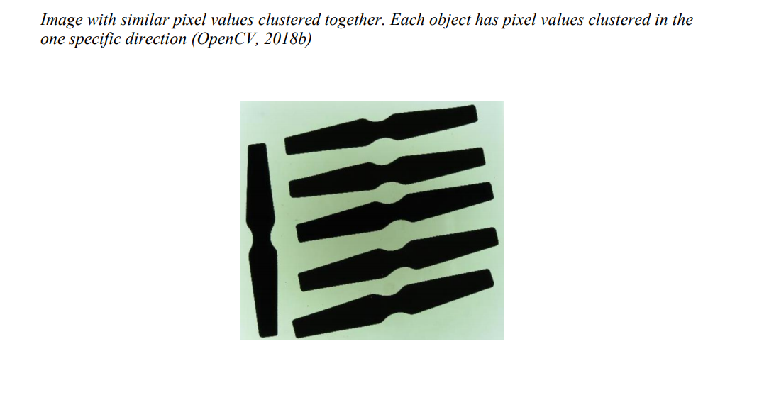
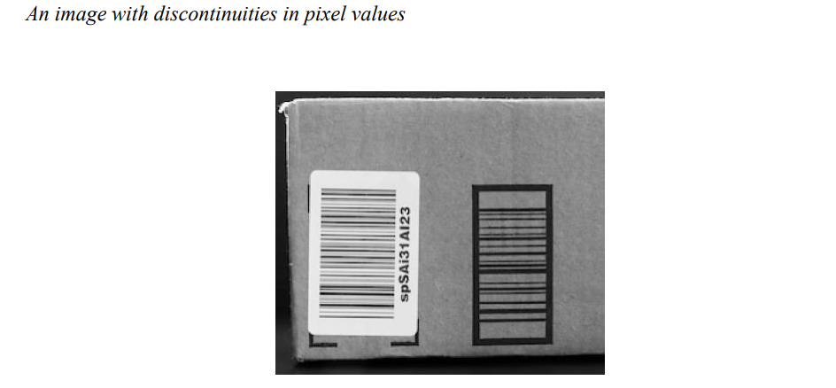
Key Points
Eigen vector analysis is compatible with data that has similar clustered pixel values, and is ineffective on images that have discontinuities in pixel values.
If the object is asymmetric, then there is a unique picture representation for every angle the picture is rotated. More emphasis is given to asymmetric objects, since objects in industry are generally asymmetric.

Slide 11
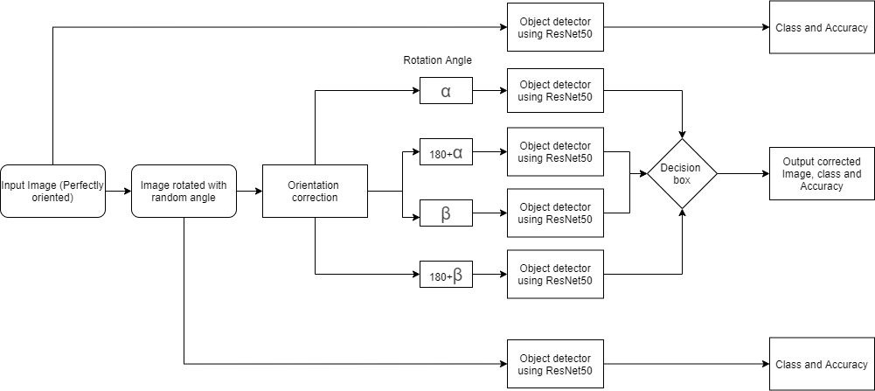

Slide 12
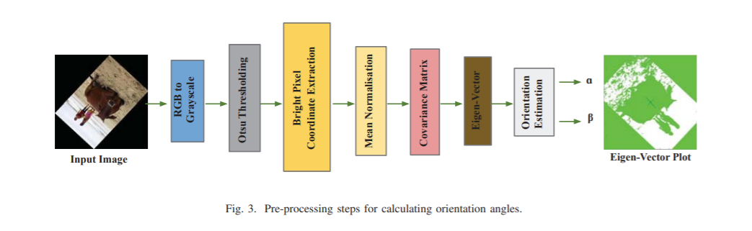

Slide 13
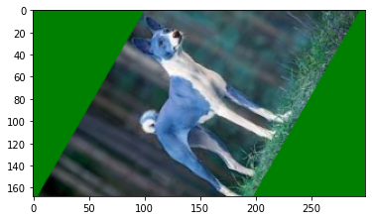
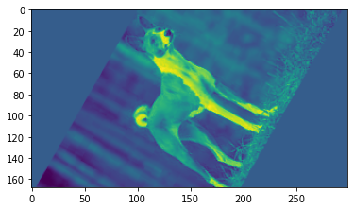
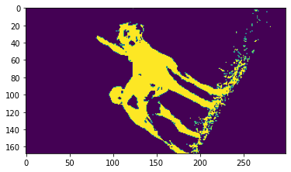
Arbitrary rotated image
Grayscale Image
Binarized Image
[[193, 183],
[193, 184],
[193, 185],
[193, 186],
[193, 187],
[193, 188],
[193, 189 ]
…
….
[193, 196]]
Eigen values:
[0.05080431 0.02752771]
Eigen Vectors:
[[ 0.74395168 -0.66823342]
[ 0.66823342 0.74395168]]
Correction angle : 48.06915190632055
Bright pixel coordinates

Slide 14
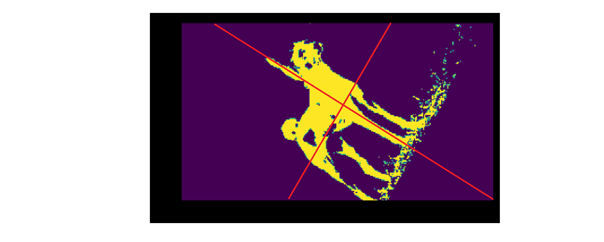
PCA will find the "best" line according to two different criteria of what is the "best".
First, the variation of values along this line should be maximal.
Second, if we reconstruct the original two characteristics (position of a blue dot) from the new one (position of a red dot), the reconstruction error (will be given by the length of the connecting red line) has to be minimum.
"the maximum variance" and "the minimum error" are reached at the same time, namely when the line points to the magenta ticks.
First Principal component of the Image.

Slide 15
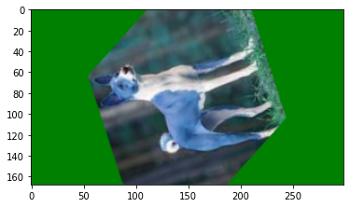
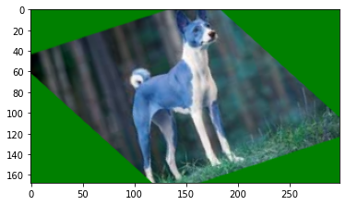
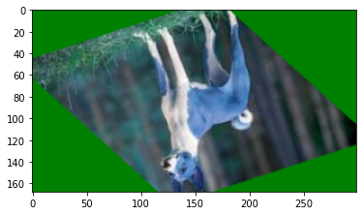
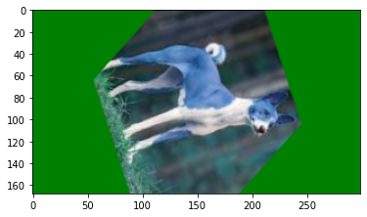

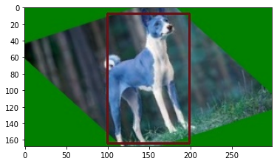
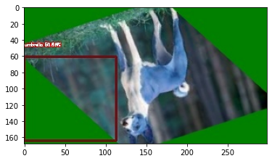
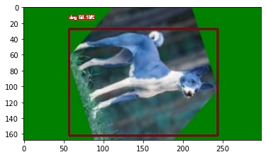
Object Detector(RESNET-50)
{
'name': 'dog’,
'percentage_probability': 59.68,
'box_points': [100, 8, 199, 164]
}
{
'name': 'umbrella’, 'percentage_probability': 50.66,
'box_points': [0, 61, 113, 164]
}
{
'name': 'dog’,
‘percentage_probability’: 58.17,
'box_points': [57, 28, 244, 162]
}

Slide 16
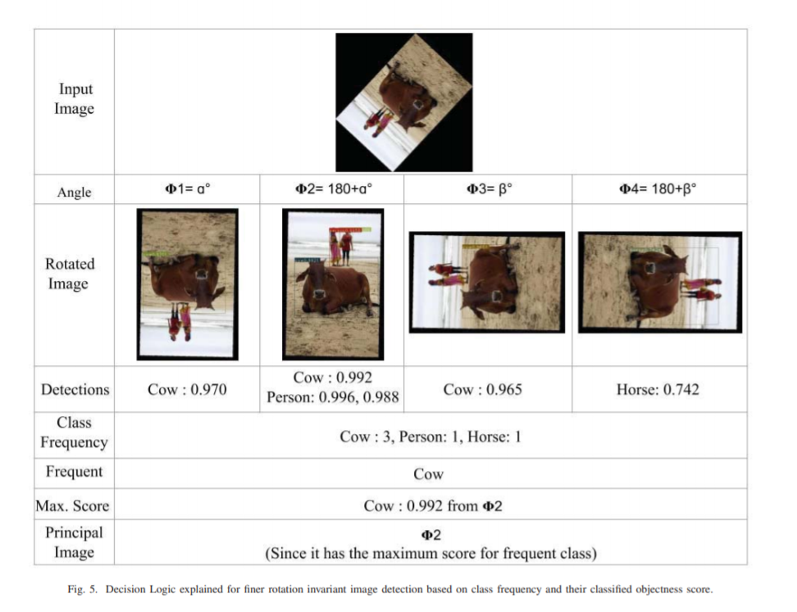

Slide 17
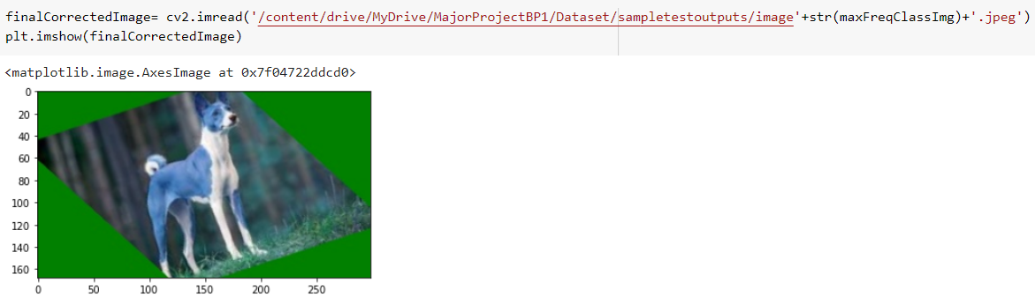
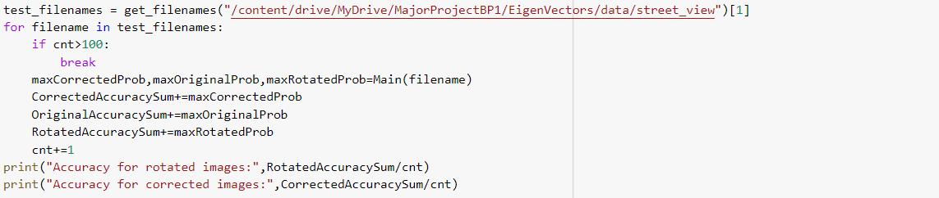
Relative performance: 1.144

Slide 18
Dataset: Stanford Dogs dataset
The Stanford Dogs dataset contains images of 120 breeds of dogs from around the world.
This dataset has been built using images and annotation from ImageNet for the task of fine-grained image categorization. It was originally collected for fine-grain image categorization, a challenging problem as certain dog breeds have near identical features or differ in color and age.
Number of categories: 120
Number of images: 20,580

Slide 19
Thank you ☺

